Slide 1
Data Visualization

Slide 2
Outline
Introduction
What is Data Visualization?
Types of Data Visualization
Selecting the type of Data Visualization

Slide 3
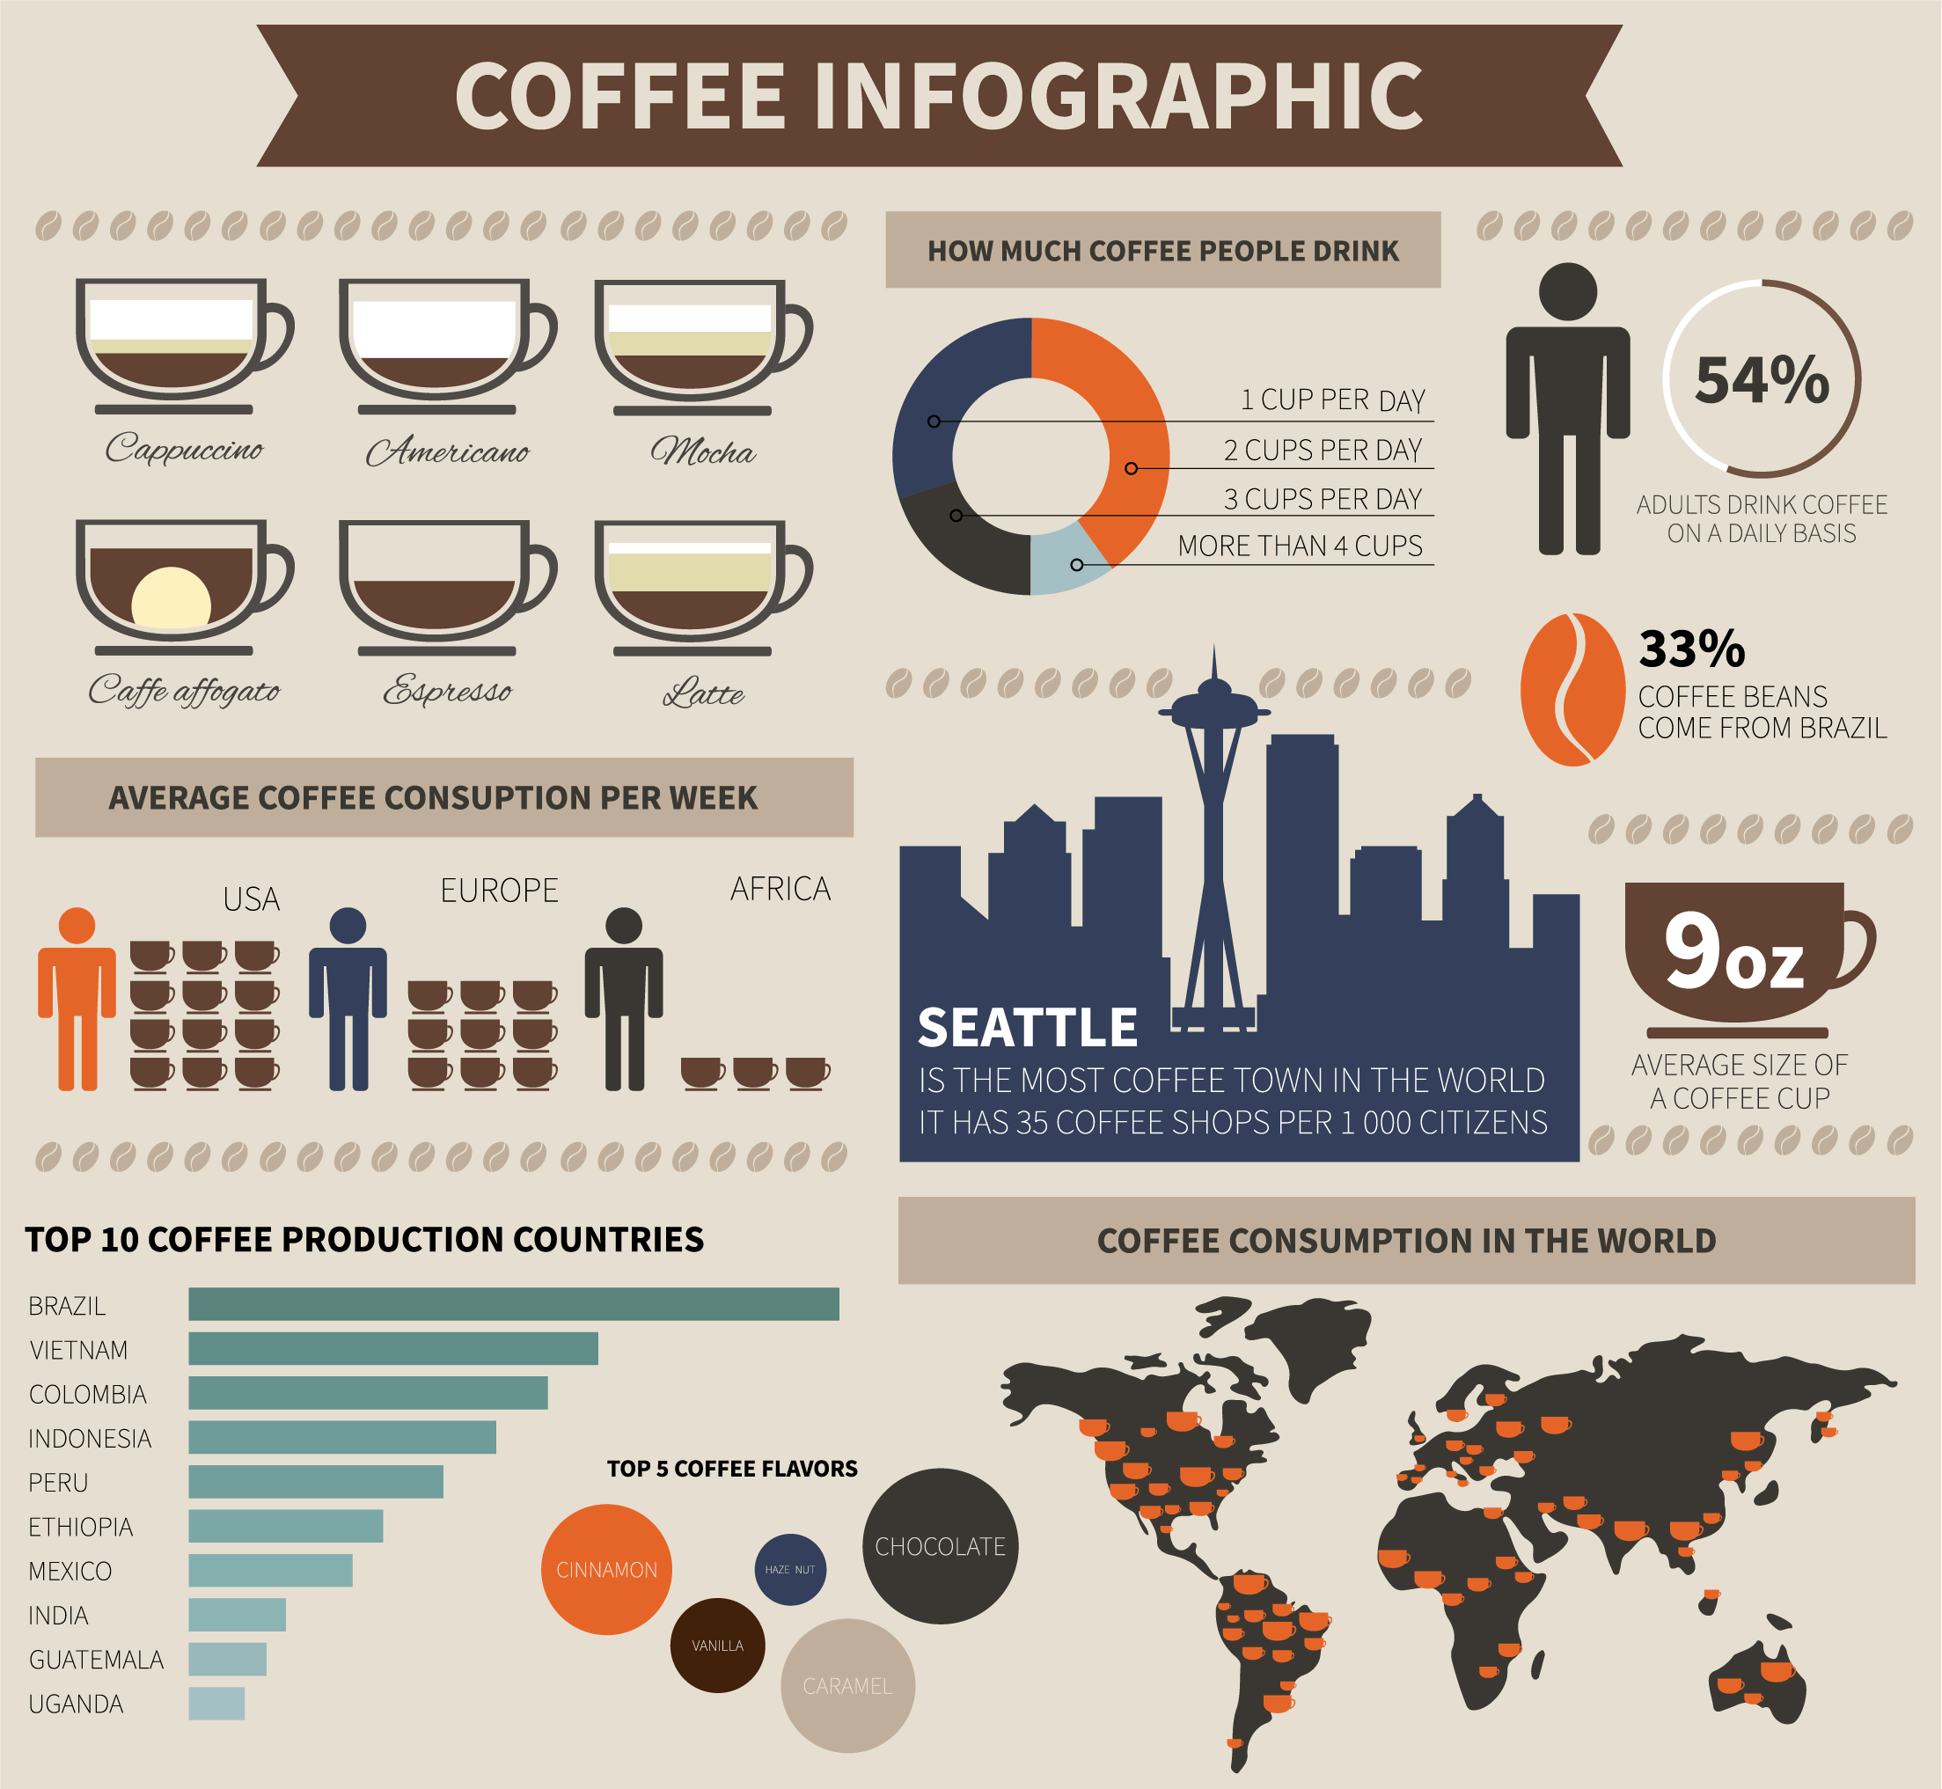
What is Data Visualization?
Data visualization is the practice of turning data into visual representation such as charts, plots, infographics, and even animations.
These visual displays of information communicate complex data relationships and data-driven insights in a way that is easy to understand.

Slide 4
What is Data Visualization?
It is used to help people see patterns, trends, and insights more clearly than they could from raw numbers or tables.

Slide 6
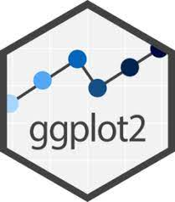



Data Visualization Tools in Python

Slide 7
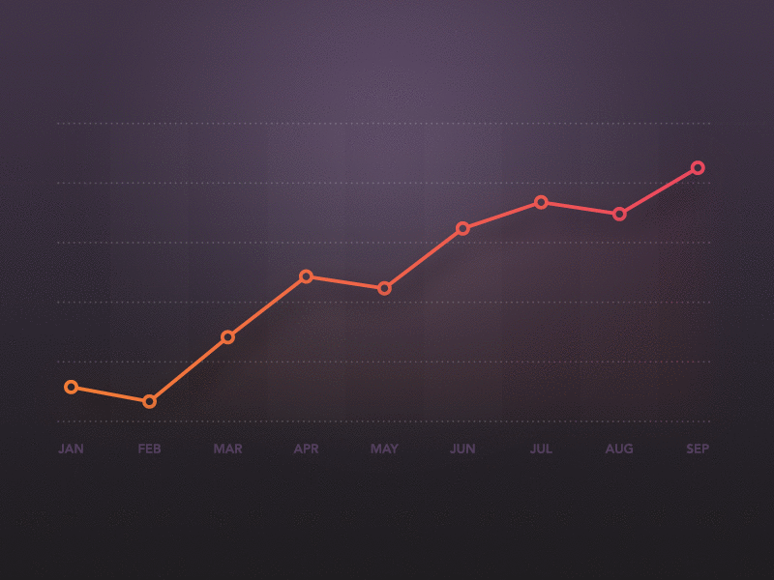
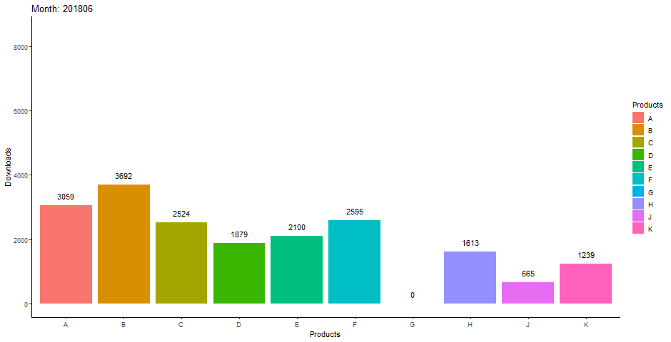
Types of Data Visualization
There are many types of data visualization. Some of the most common types used are:
Column Chart
Line Chart

Slide 8
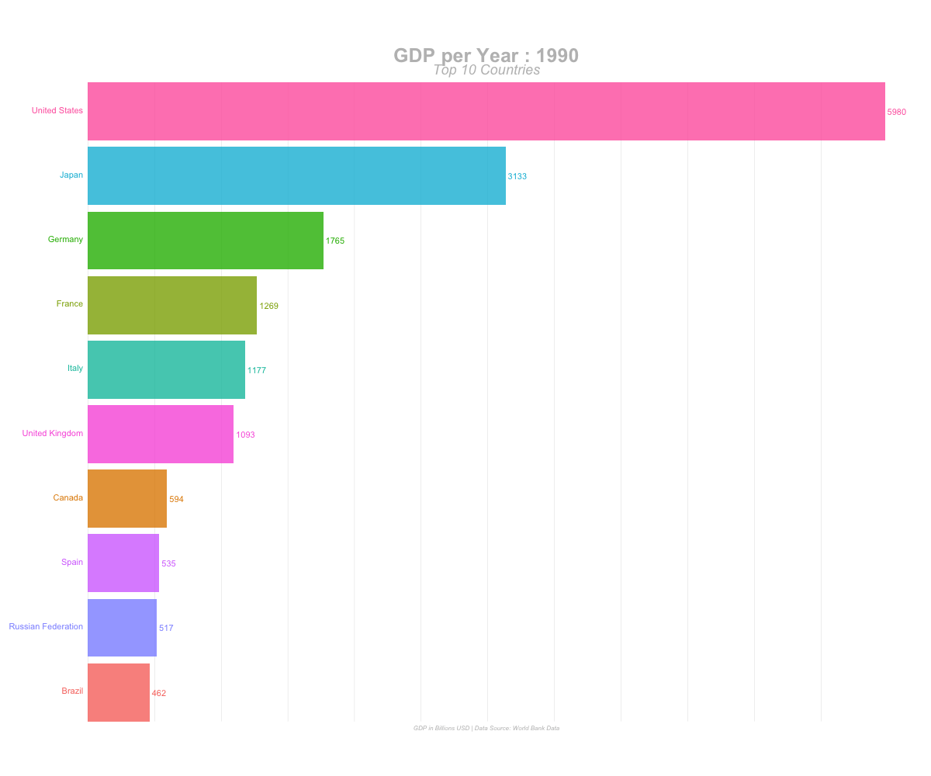
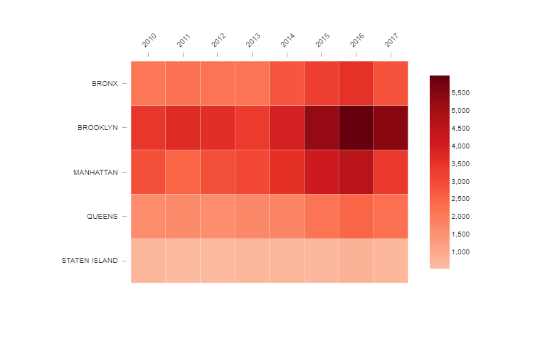
Types of Data Visualization
There are many types of data visualization. Some of the most common types used are:
Bar Graph/Chart
Heat Map

Slide 9
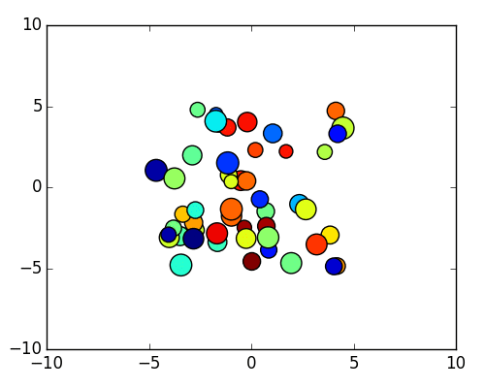
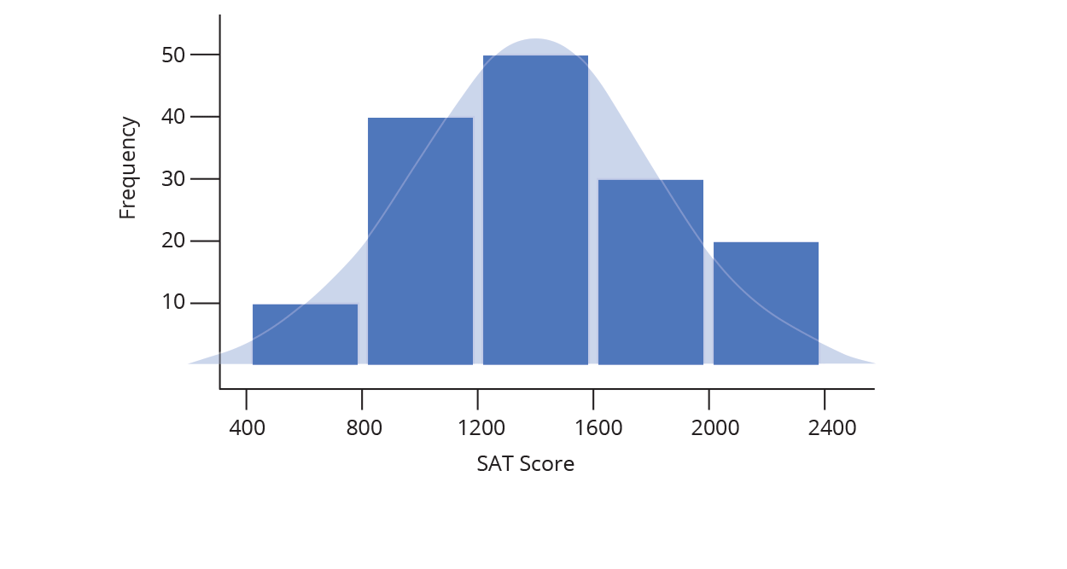
Types of Data Visualization
There are many types of data visualization. Some of the most common types used are:
Scatter Plot
Histogram

Slide 10
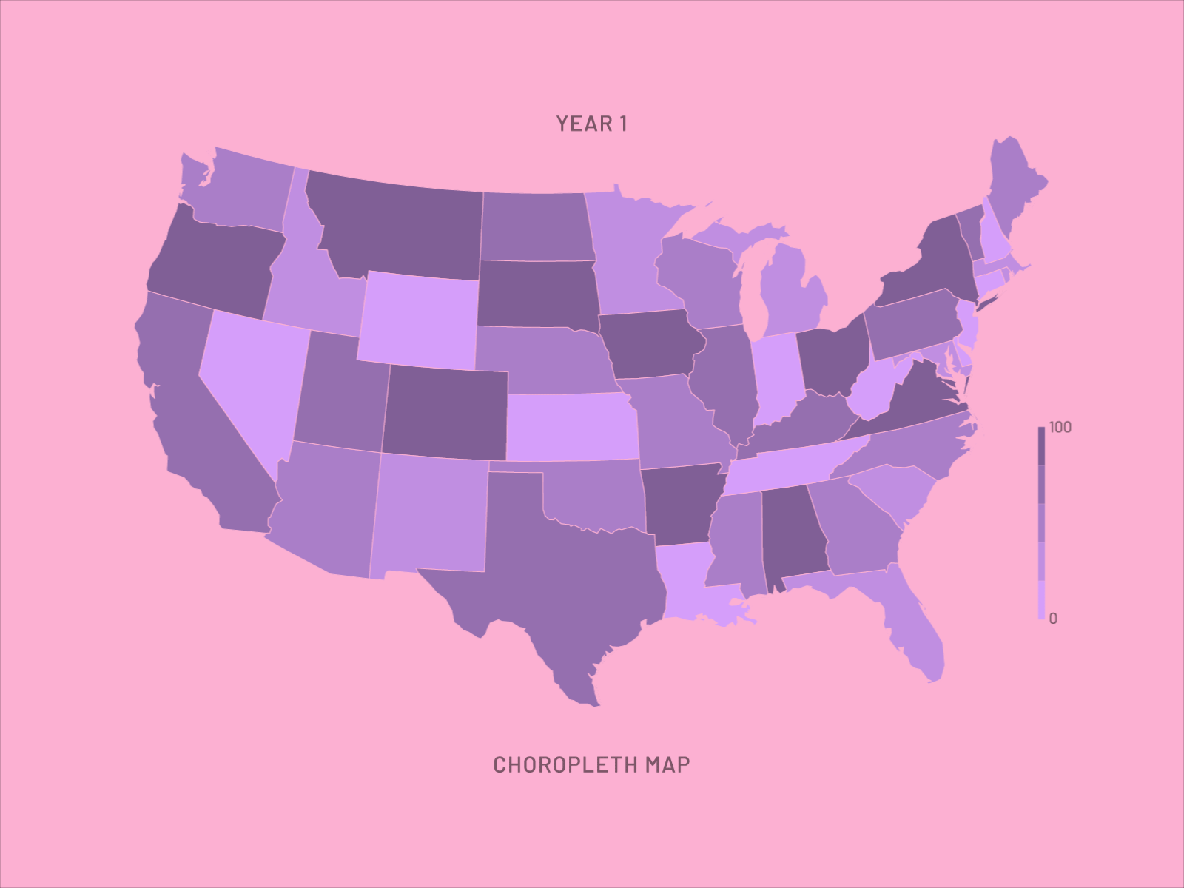
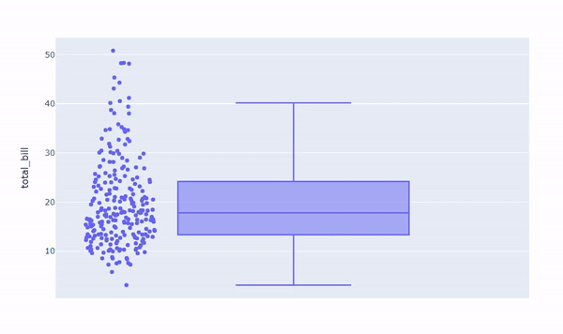
Types of Data Visualization
There are many types of data visualization. Some of the most common types used are:
Chloropleth Map
Box/Whisker Plot

Slide 11
Outline
Introduction
What is EDA?
Descriptive Statistics
Central Tendency
Dispersion
Shape
Data Visualization

Slide 12
Column Chart
They are a straightforward, time-tested method of comparing several collections of data. A column chart may be used to track data sets across time.

Slide 13
Line Chart
A line graph is used to show trends, development, or changes through time.
As a result, it functions best when your data collection is continuous as opposed to having many beginnings and ends.

Slide 14
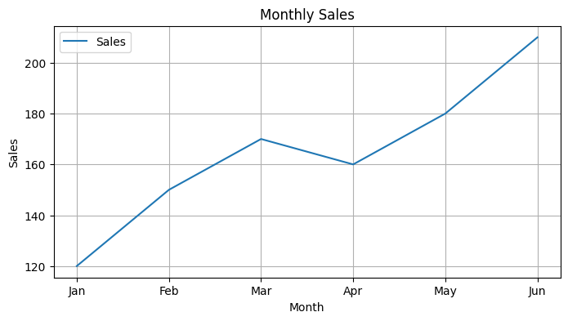
import pandas as pd
import matplotlib.pyplot as plt
# Sample data
data = {
"Month": ["Jan", "Feb", "Mar", "Apr", "May", "Jun"],
"Sales": [120, 150, 170, 160, 180, 210]
}
df = pd.DataFrame(data)
df.set_index("Month", inplace=True)
# Plot line chart
df.plot(kind="line", figsize=(8, 4))
plt.title("Monthly Sales")
plt.xlabel("Month")
plt.ylabel("Sales")
plt.grid(True)
plt.show()

Slide 15
Bar Chart
To compare data along two axes, use bar charts.
A visual representation of the categories or subjects being measured is shown on one of the axes, which is numerical.

Slide 16
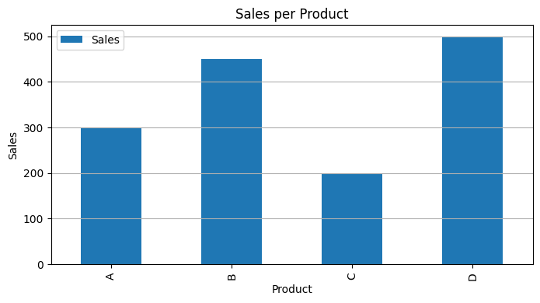
import pandas as pd
import matplotlib.pyplot as plt
data = {
"Product": ["Phone", "Playstation", "Keyboard", "Monitor"],
"Sales": [300, 450, 200, 500]
}
df = pd.DataFrame(data)
df.set_index("Product", inplace=True)
df.plot(kind="bar", figsize=(8, 4))
plt.title("Sales per Product")
plt.xlabel("Product")
plt.ylabel("Sales")
plt.grid(axis="y")
plt.show()

Slide 17
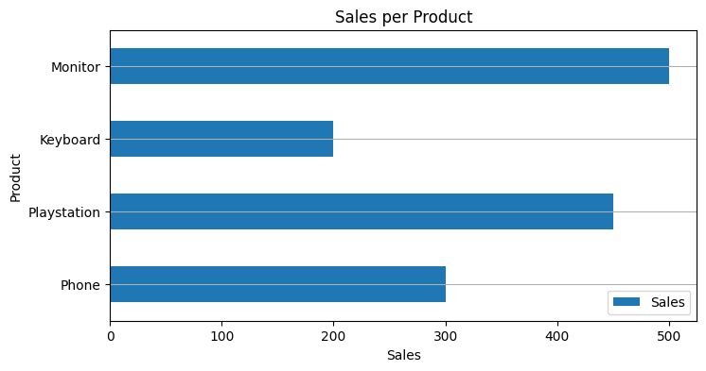
import pandas as pd
import matplotlib.pyplot as plt
data = {
"Product": ["Phone", "Playstation", "Keyboard", "Monitor"],
"Sales": [300, 450, 200, 500]
}
df = pd.DataFrame(data)
df.set_index("Product", inplace=True)
df.plot(kind="barh", figsize=(8, 4))
plt.title("Sales per Product")
plt.xlabel(“Sales")
plt.ylabel(“Product")
plt.grid(axis="y")
plt.show()

Slide 18
Heat Map
A data visualization method that uses colors to denote values
Each cell represents the correlation between two subjects.
Brighter or darker colors indicate stronger or weaker relationships

Slide 19
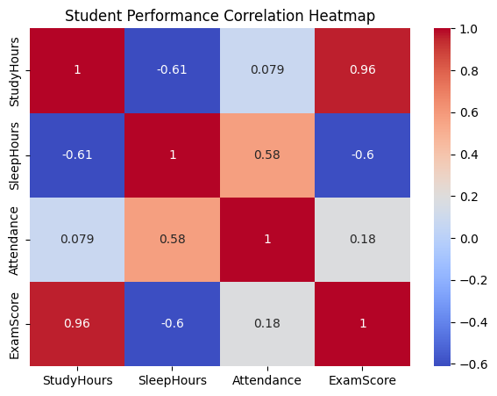
import pandas as pd
import seaborn as sns
import matlplotlib.pyplot as plt
data = {
"StudyHours": [2, 3, 4, 5, 1, 6, 3, 4],
"SleepHours": [7, 6, 8, 5, 9, 6, 7, 8],
"Attendance": [90, 85, 95, 80, 88, 92, 84, 93],
"ExamScore": [78, 82, 88, 90, 70, 95, 76, 84]
}
df = pd.DataFrame(data)
corr = df.corr()
plt.figure(figsize=(7, 5))
sns.heatmap(corr, annot=True, cmap="coolwarm")
plt.title("Student Performance Correlation Heatmap")
plt.show()

Slide 20
Scatter Plot
The correlation between variables is examined using a scatter plot. At the point where the data's two values overlap, the data are represented on the graph as dots.

Slide 21
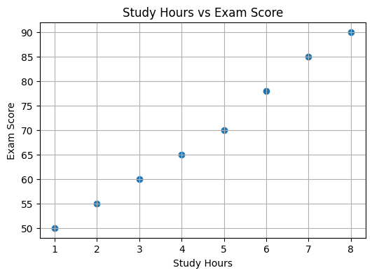
import pandas as pd
import matplotlib.pyplot as plt
data = {
"StudyHours": [1, 2, 3, 4, 5, 6, 7, 8],
"ExamScore": [50, 55, 60, 65, 70, 78, 85, 90]
}
df = pd.DataFrame(data)
# Scatter plot
plt.figure(figsize=(6, 4))
plt.scatter(df["StudyHours"], df["ExamScore"])
plt.title("Study Hours vs Exam Score")
plt.xlabel("Study Hours")
plt.ylabel("Exam Score")
plt.grid(True)
plt.show()

Slide 22
Histogram
While a histogram and a bar graph are similar, they use distinct charting systems.
The ideal sort of data visualization for frequency-based analysis of data ranges is a histogram.

Slide 23
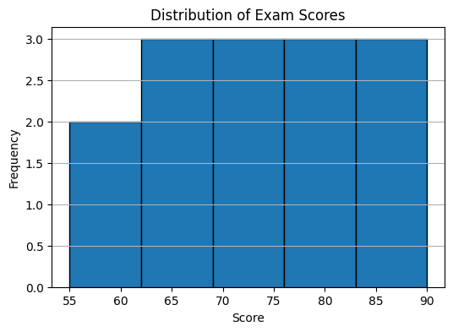
import pandas as pd
import matplotlib.pyplot as plt
# Sample data
data = {
"ExamScore": [55, 60, 62, 65, 68, 70, 72, 75, 78, 80, 82, 85, 88, 90]
}
df = pd.DataFrame(data)
# Histogram
plt.figure(figsize=(6, 4))
df["ExamScore"].plot(kind="hist", bins=5, edgecolor="black")
plt.title("Distribution of Exam Scores")
plt.xlabel("Score")
plt.ylabel("Frequency")
plt.grid(axis="y")
plt.show()

Slide 24
Chloropleth
The technique of color mapping symbology is used to create choropleth maps, which are themed maps used to display statistical data.
It shows geographically segmented sections or regions that are colored, shaded, or patterned according to a data variable, known as enumeration units.

Slide 25
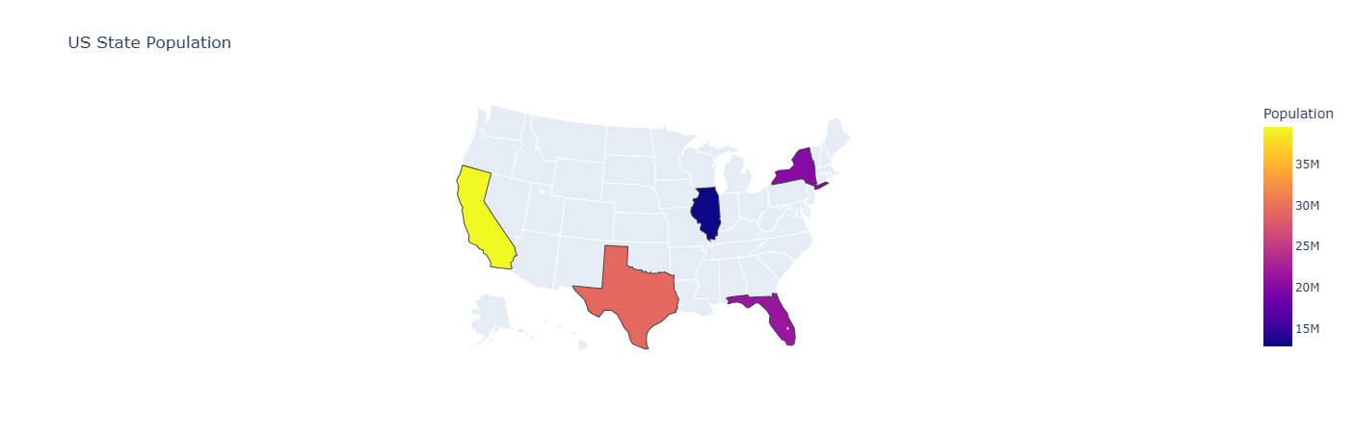
import pandas as pd
import plotly.express as px
import plotly.io as pio
pio.renderers.default = "vscode"
# Step 1: Prepare the Data
data = {
'State': ['California', 'Texas', 'Florida', 'New York', 'Illinois'],
'State_Code': ['CA', 'TX', 'FL', 'NY', 'IL'],
'Population': [39538223, 29145505, 21538187, 20201249, 12812508]
}
df = pd.DataFrame(data)
# Step 2: Create the Choropleth Map
fig = px.choropleth(
df,
locations="State_Code",
locationmode="USA-states",
color="Population",
scope="usa",
title="US State Population")
# Step 3: Display the map
fig.show()

Slide 27
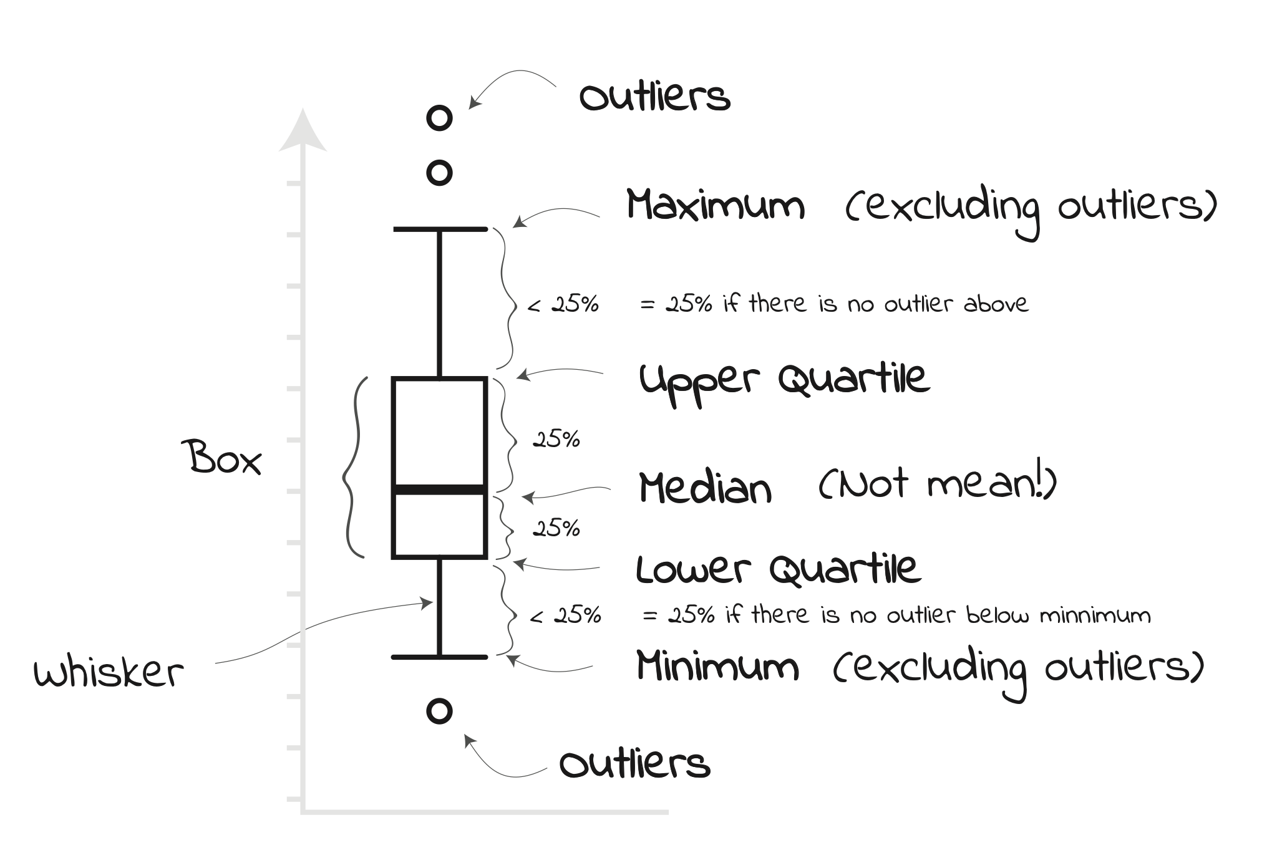
Boxplot
A Box Plot is also known as a Box and Whisker Plot and it is a graphical tool used to understand the distribution of numerical data.

Slide 29
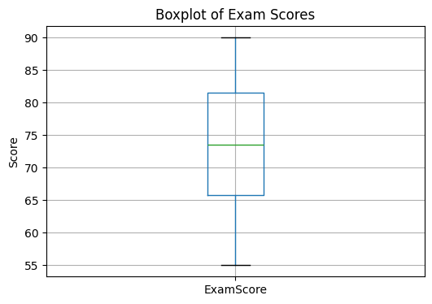
import pandas as pd
import matplotlib.pyplot as plt
# Sample dataset
data = {
"ExamScore": [55, 60, 62, 65, 68, 70, 72, 75, 78, 80, 82, 85, 88, 90]
df = pd.DataFrame(data)
# Create boxplot
plt.figure(figsize=(6, 4))
df.boxplot(column="ExamScore")
plt.title("Boxplot of Exam Scores")
plt.ylabel("Score")
plt.grid(True)
plt.show()

Slide 30
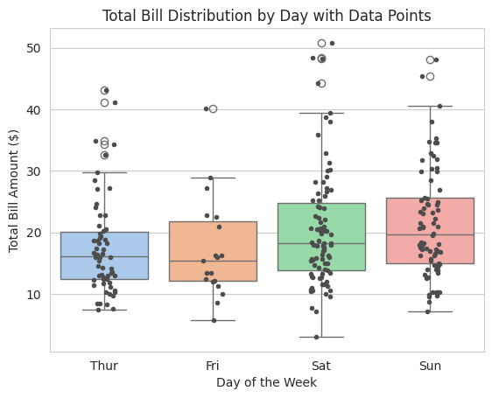
import pandas as pd
import seaborn as sns
import matplotlib.pyplot as plt
df = sns.load_dataset('tips')
# Set a nice visual style
sns.set_style("whitegrid")
# Create the boxplot
ax = sns.boxplot(x='day', y='total_bill', data=df, palette="pastel")
# Overlay the individual data points using stripplot
sns.stripplot(x='day', y='total_bill', data=df, color=".3", jitter=True, size=4, ax=ax)
# Add title and labels
plt.title("Total Bill Distribution by Day with Data Points")
plt.xlabel("Day of the Week")
plt.ylabel("Total Bill Amount ($)")
# Display the plot
plt.show()

Slide 32
References

